Slide 1
INTERNET OF THINGS(18EC64) MODULE-3

Slide 2
THE BUSINESS CASE FOR IP
Data flowing from or to “things” is consumed, controlled, or monitored
Dedicated applications are then run over virtualized or traditional operating systems or on network edge platforms (for ex-ample, fog computing).
The system solutions combining various physical and data link layers call for an architectural approach with a common layer(s) independent from the lower (connectivity) and/or upper (application) layers
--iP Llayer-1990s
Ip is preferred in both IT and OT

Slide 3
KEY ADVANTAGES OF INTERNET PROTOCOL
Open and standards-based
Versatile
Ubiquitous
Scalable
Manageable and highly secure
Stable and resilient
Consumers’ market adoption
The innovation factor

Slide 4
Adoption or Adaptation of the Internet Protocol
Bidirectional versus unidirectional data flow
Overhead for last-mile communications paths
Data flow model
Network diversity

Slide 5
THENEEDFOR OPTIMISATION
Constrained nodes
Devices that are very constrained in resources, may communicate infrequently to transmit a few bytes, and may have limited security and management capabilities
Devices with enough power and capacities to implement a stripped-down IP stack or non-IP stack.
Devices that are similar to generic PCs in terms of computing and power resources but have constrained networking capacities, such as bandwidth

Slide 6
CONSTRAINED NETWORKS
Network bandwidth capacity was restrained
Constrained networks have unique characteristics and requirements
They operate between a few kbps and a few hundred kbps
Control plane traffic must also be kept at a minimum
The power consumption in battery-powered nodes must be considered
Constrained nodes and networks pose major challenges for IoT connectivity in the last mile

Slide 7
IP VERSIONS
Application Protocol
Cellular Provider and Technology
Serial Communications
IPv6 Adaptation Layer

Slide 8
OPTIMIZING IP FOR IOT

Slide 9
FROM6LoWPAN to 6lo

Slide 10
6lowpan headercompression

Slide 13
6TiSCH

Slide 14
5TISCHSCHEDULEMANAGEMENT METHODS
Static scheduling
Neighbor-to-neighbor scheduling
Remote monitoring and scheduling management
Hop-by-hop scheduling

Slide 15
6TISCH FORWARDING MODELS
Track Forwarding (TF)
Fragment forwarding (FF)
IPv6 Forwarding (6F)

Slide 16
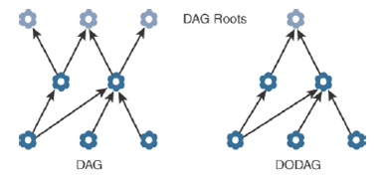
RPL(IPV6 ROUTING PROTOCOL FOR LOW POWER LOSSY NETWORK

Slide 17
RPL OVERVIEW

Slide 18
RPL METRICES
Expected Transmission Count (ETX)
Hop Count
Latency
Link Quality Level
Link Color
Node State and Attribute
Node Energy
Throughput

Slide 19
Authentication and Encryption on Constrained Nodes
Authentication and Authorization for Constrained Environments (ACE)
DTLS in Constrained Environments (DICE)

Slide 20
PROFILES AND COMPLIANCES
Internet Protocol for Smart objects (IPSO) Alliance
Wi-SUN Alliance
Thread
IPv6 Ready Logo

Slide 21
APPLICATION PROTOCOLS FOR IOT
Transmission Control Protocol (TCP)
-transport large volumes of data into smaller sets of packets
-reassembly in a correct sequence, flow control and window adjustment, and retransmission of lost packets
User Datagram Protocol (UDP)
-Domain Name System (DNS)
-Dynamic Host Control Protocol (DHCP)
-performance and latency are more import-ant than packet retransmissions because re-sending a lost voice or video packet does not add value

Slide 22
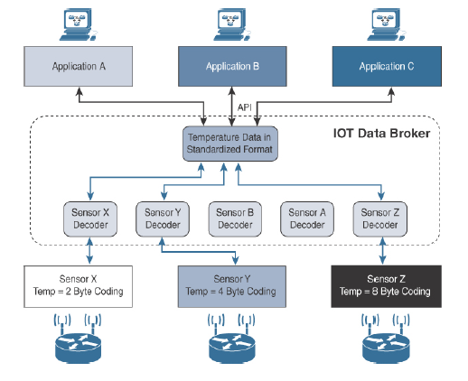
IOT APPLICATION TRANSPORT METHODS
Application layer protocol not present

Slide 23
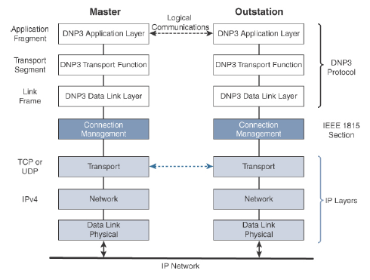
Supervisory control and data acquisition (SCADA)
Adapting SCADA for IP

Slide 24
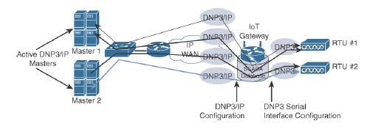
SCADA Protocol Translation

Slide 25
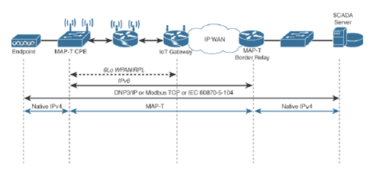
SCADA Transport over LLNs with MAP-T

Slide 26
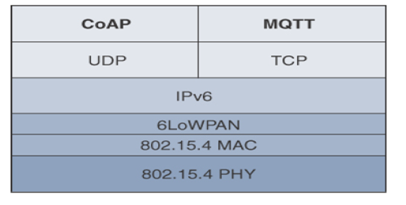
Generic Web-Based Protocols
HTTP/HTTPS client/server model
IoT Application Layer Protocols

Slide 27
CoAP
Constrained Application Protocol (CoAP)
RFC 6690: Constrained RESTful Environments (CoRE) Link Format
RFC 7252: The Constrained Application Protocol (CoAP)
RFC 7641: Observing Resources in the Constrained Application Protocol (CoAP)
RFC 7959: Block-Wise Transfers in the Constrained Application Protocol (CoAP)
RFC 8075: Guidelines for Mapping Implementations: HTTP to the Constrained Application Protocol (CoAP).

Slide 28
COAP MESSAGE FORMAT

Slide 29
DIFFERENCES BETWEEN COAP AND MQTT

Slide 30
CoAP Reliable Transmission Example

Slide 31
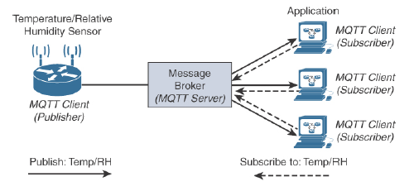
Message Queuing Telemetry Transport (MQTT)
client/server and publish/ subscriber framework
transport using port 1883
MQTT is a lightweight protocol

Slide 32
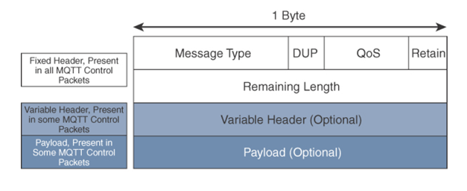
Mqtt message format

Slide 33
MQTT QOS FLOW

Slide 34
DIFFERENCES BETWEEN COAP AND MQTT

